Slide 1


Alpha Phi Omega
Chi Chapter at UCLA
Alpha Mu / Kay Krenek Term, Meeting 9
January 7, 2014
www.apo-x.org

Slide 2
Agenda
1. Officer Updates and Announcements
2. Elections
3. Last Announcements

Slide 3
President
Raymond Mai
president@apo-x.org
Executive Committee
excomm@apo-x.org

Slide 4
[AN] Excomm Elections
GOOD LUCK TO ALL CANDIDATES!
Remember that it is a privilege to run and if you win, it is an honor for the chapter to vote you in
Do all in your ability to do what is best for the chapter, not what is best for yourself
As a leader, the needs of the people and organization you lead comes before your needs

Slide 5
Administrative VPs
Kevin Quizon & Nicola Yip
admin@apo-x.org

Slide 6
Alumni Mentorship

Slide 7
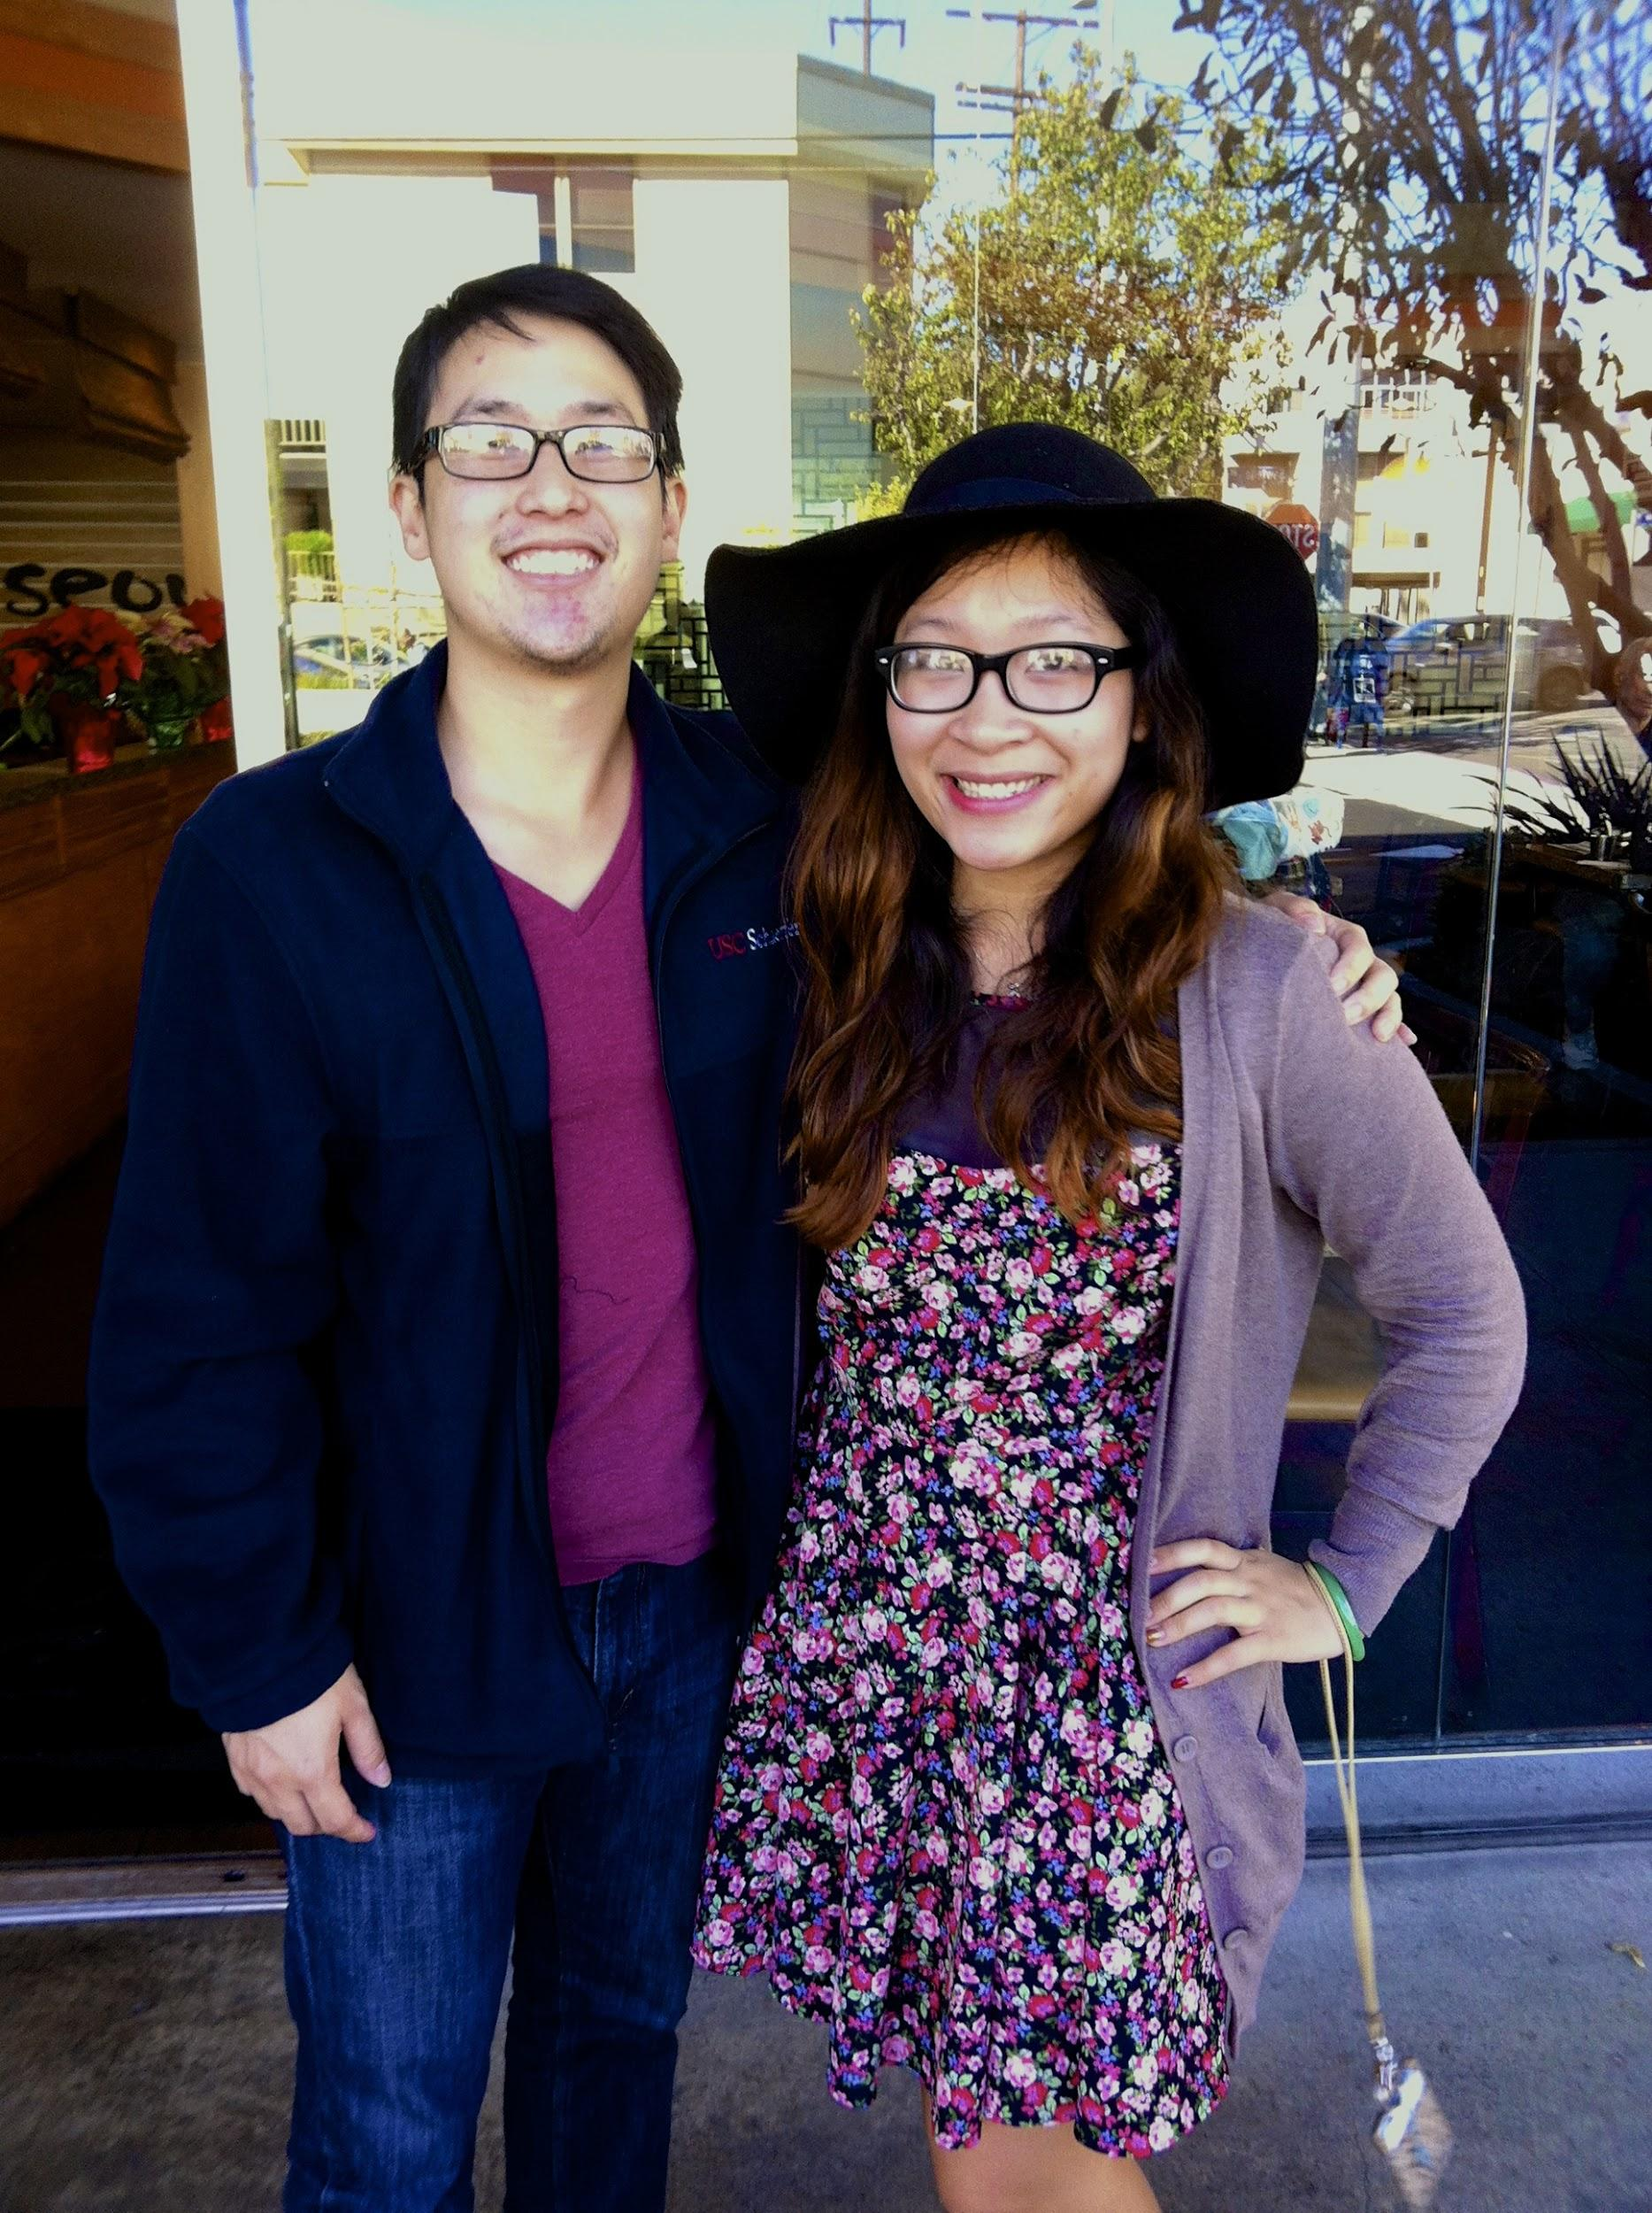
Alumni Mentorship
Nancy Nguyen
&
Daniel Hanaya!
“Daniel can make the most sarcastic remarks with a very, very serious face :o”

Slide 8
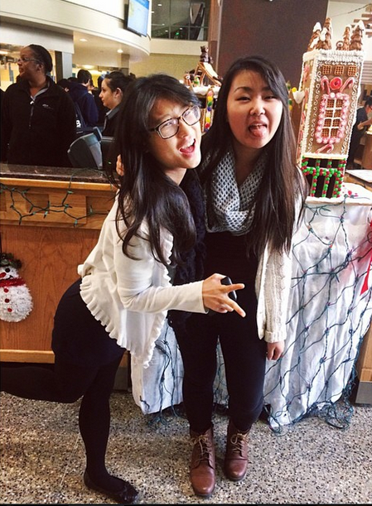
Alumni Mentorship
Rita Chan
&
Jessica Chen!
follow Rita on instagram: @ritakyc

Slide 9
MEMBERSHIP.
Jeremy Gozzip & Andrew Suh
membership@apo-x.org

Slide 10

Active Requirements
ACTIVE REQUIREMENTS DUE
TUESDAY, JANUARY 27th, 11:59PM.

Slide 11
Chapter Event
Remaining chapter events:
Ski trip, Activation, NEW EVENT NEXT WEEK
*BEFORE NEXT WEEK’S MEETING!
6pm meet outside the meeting room
Better start brushing up on your trivia. ;)

Slide 12
AΘ

Slide 13
Golden Eagle Nominations
Deadline: 1/14/2015 11:59pm
-Located under “Quick Links” on the right side of www.apo-x.org after login.

Slide 14
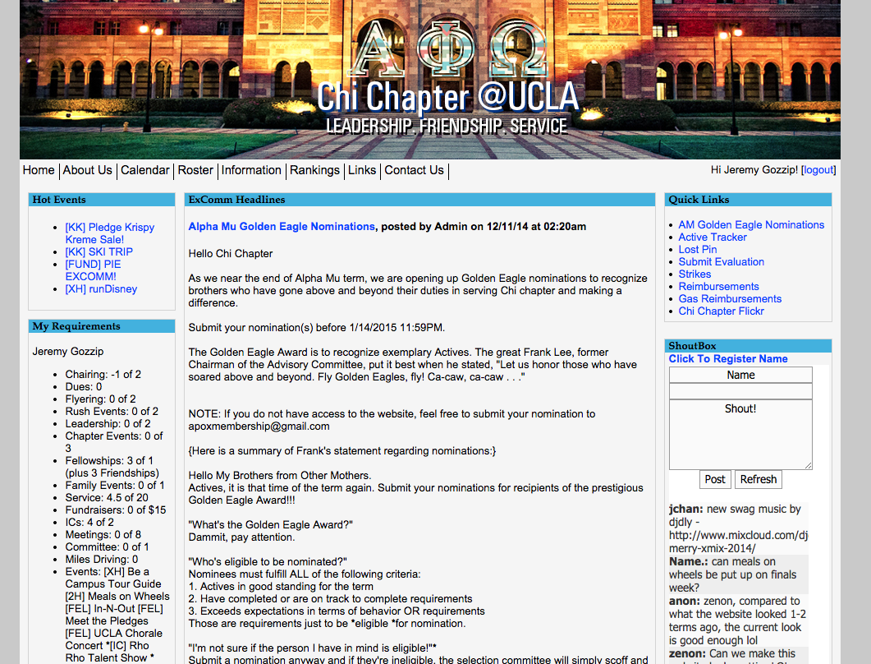
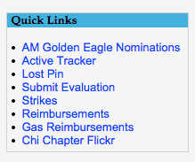
Golden Eagle Nominations

Slide 15
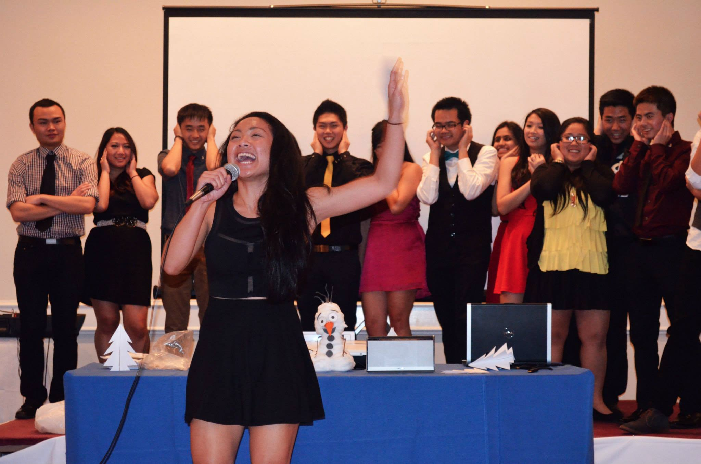

Slide 16
LFS/EMH
Voting CM 10
LFS: 1 Active + 1 Pledge for each category
(L, F, and S)
EMH: 1 Active who you believe gave it their all this term to make our chapter better.

Slide 17
Ski Trip
-Who gots their own gear?

Slide 18
Service VP
Rui Guo
apoxservice@gmail.com

Slide 19

runDisney
Please update the calendar event if you are still interested in going!
Last day to sign up is Thursday at midnight

Slide 20

Make Blankets for Service!
It’s a calendar event now! Most nights from 7-9pm
If you are still interested in making your own, you are still welcome to!
However materials will no longer be provided

Slide 21

Pledge Parents
Brian Lee & Emily Neai-Proeung
apoxpparents@gmail.com

Slide 22
Requirements Due
All due next week Jan. 14 by 6:00PM.

Slide 23

Makeup Video in CM meeting
https://drive.google.com/file/d/0B-MvyTM0XQmiekRuNFNNQUVmRHM/view?usp=sharing
http://youtu.be/i1FtF_xzNig

Slide 24
Finance VPs
San Li & Jonathan Liu
finance@apo-x.org

Slide 25
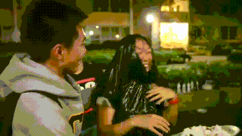
Pie Excomm
Moved to Tues. Jan 13 @ 6:30-7:30pm
This will be the last chance for pledges to complete their fundraising.

Slide 26
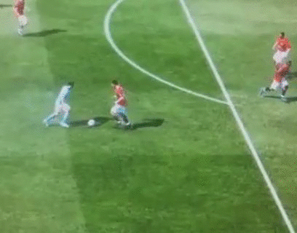
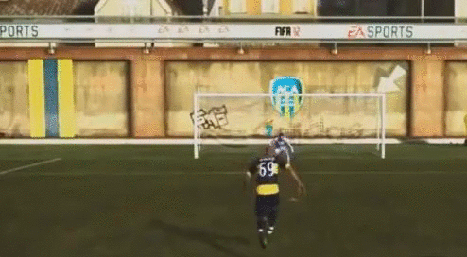
Fundraising Tracker
Tracker has been updated as of Jan 3 for both actives and pledges
Contact us if there are any errors
For pledges with <$10 fundraising, expect an email by Thursday night.

Slide 27
Fellowship VPs
Ann Dai & Danny Ly
fellowship@apo-x.org

Slide 28


happy new year!
Secret Santa!!
Let us know if you were late and couldn’t give it to us in the beginning of meeting

Slide 29
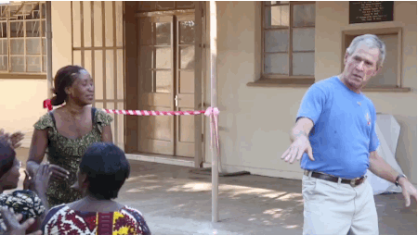
Banquet
Please sign up for Banquet 1/31
Prices:
$38 for Good standing/Pledges/Alumni
$48 for Bad standing
$50 for Non-APO guests
PLS PAY ASAP
LAST DAY TO PAY IS 1/28!!

Slide 30


events
The tracker is up to date =)
Let us know if you would like any events up!

Slide 31

Historian
Juana Li
historian@apo-x.org

Slide 32
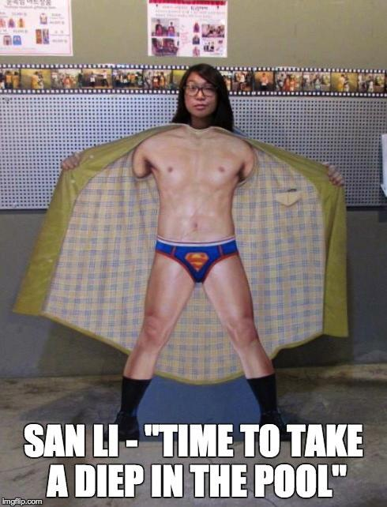
Brothers of Chi Chapter

Slide 33

Webisode 4
https://www.youtube.com/watch?v=JzI3PdsgT0M&index=3&list=PLsVaMeiV0N4JeYXoTlagyNuZ2l8Zd3rc_

Slide 34
Sergeant-at-Arms
George Hsin
apoxsergeant@gmail.com

Slide 36
Interchapter Chair
Chanel Ng
interchapter@apo-x.org

Slide 37

IC Events
Welcome Mu Zeta Chapter!

Slide 38
IC Events
Diddy Riese hangout after! (Cap: 12)
Jan 11th, 4pm, LACMA
Jan 13th, 8:30pm, AU79

Slide 39
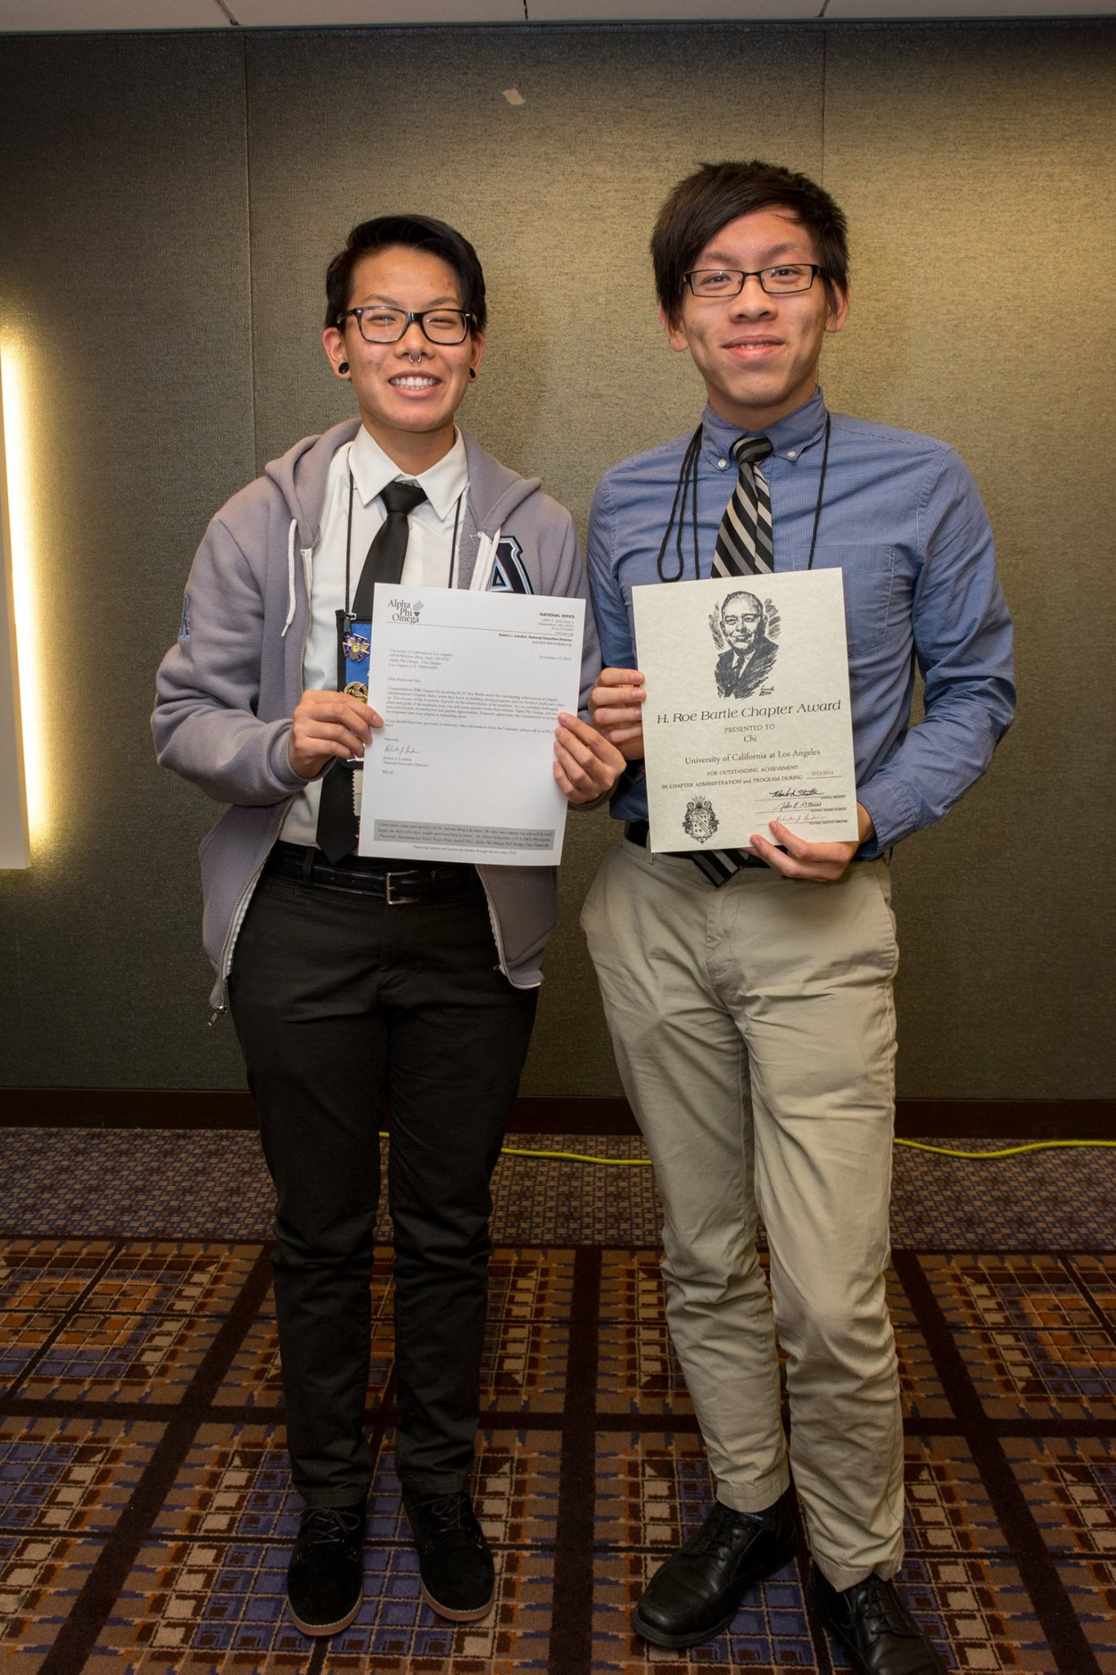
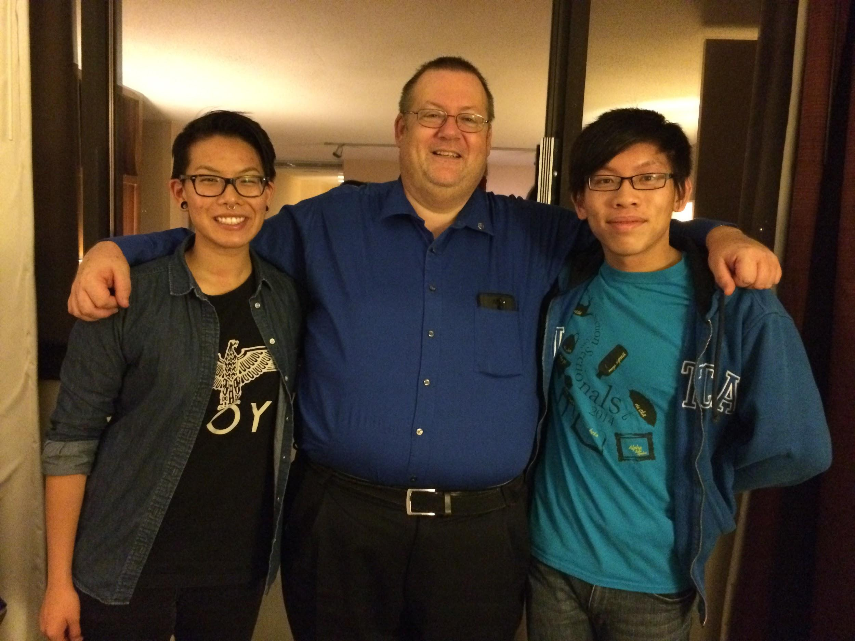
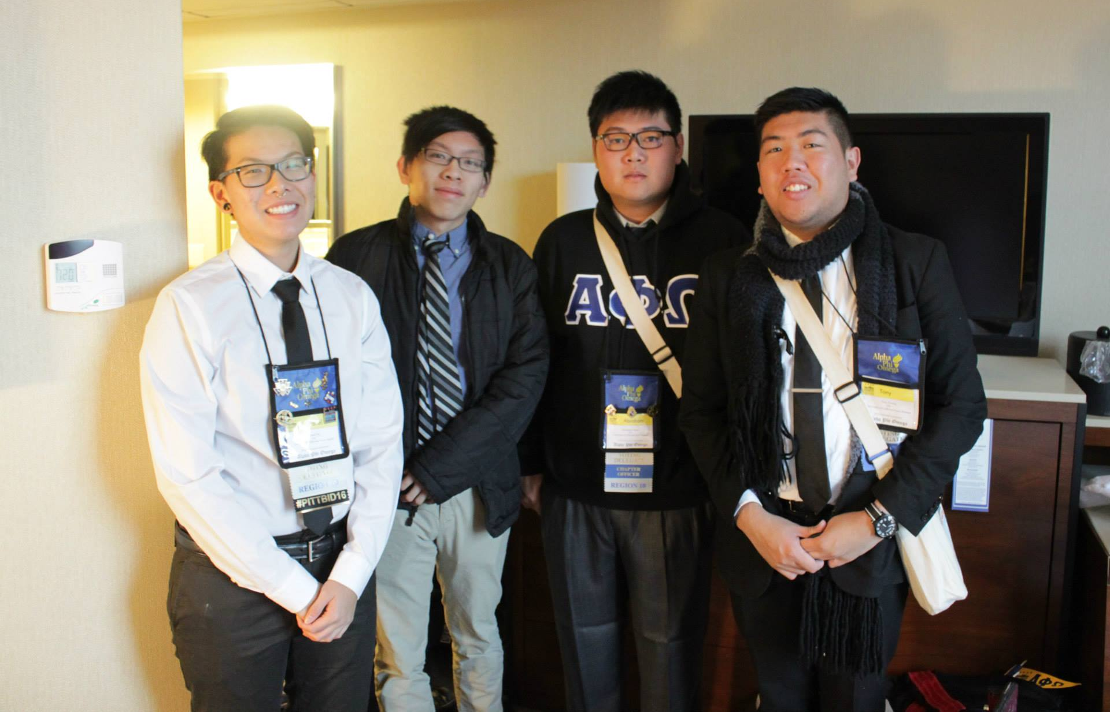
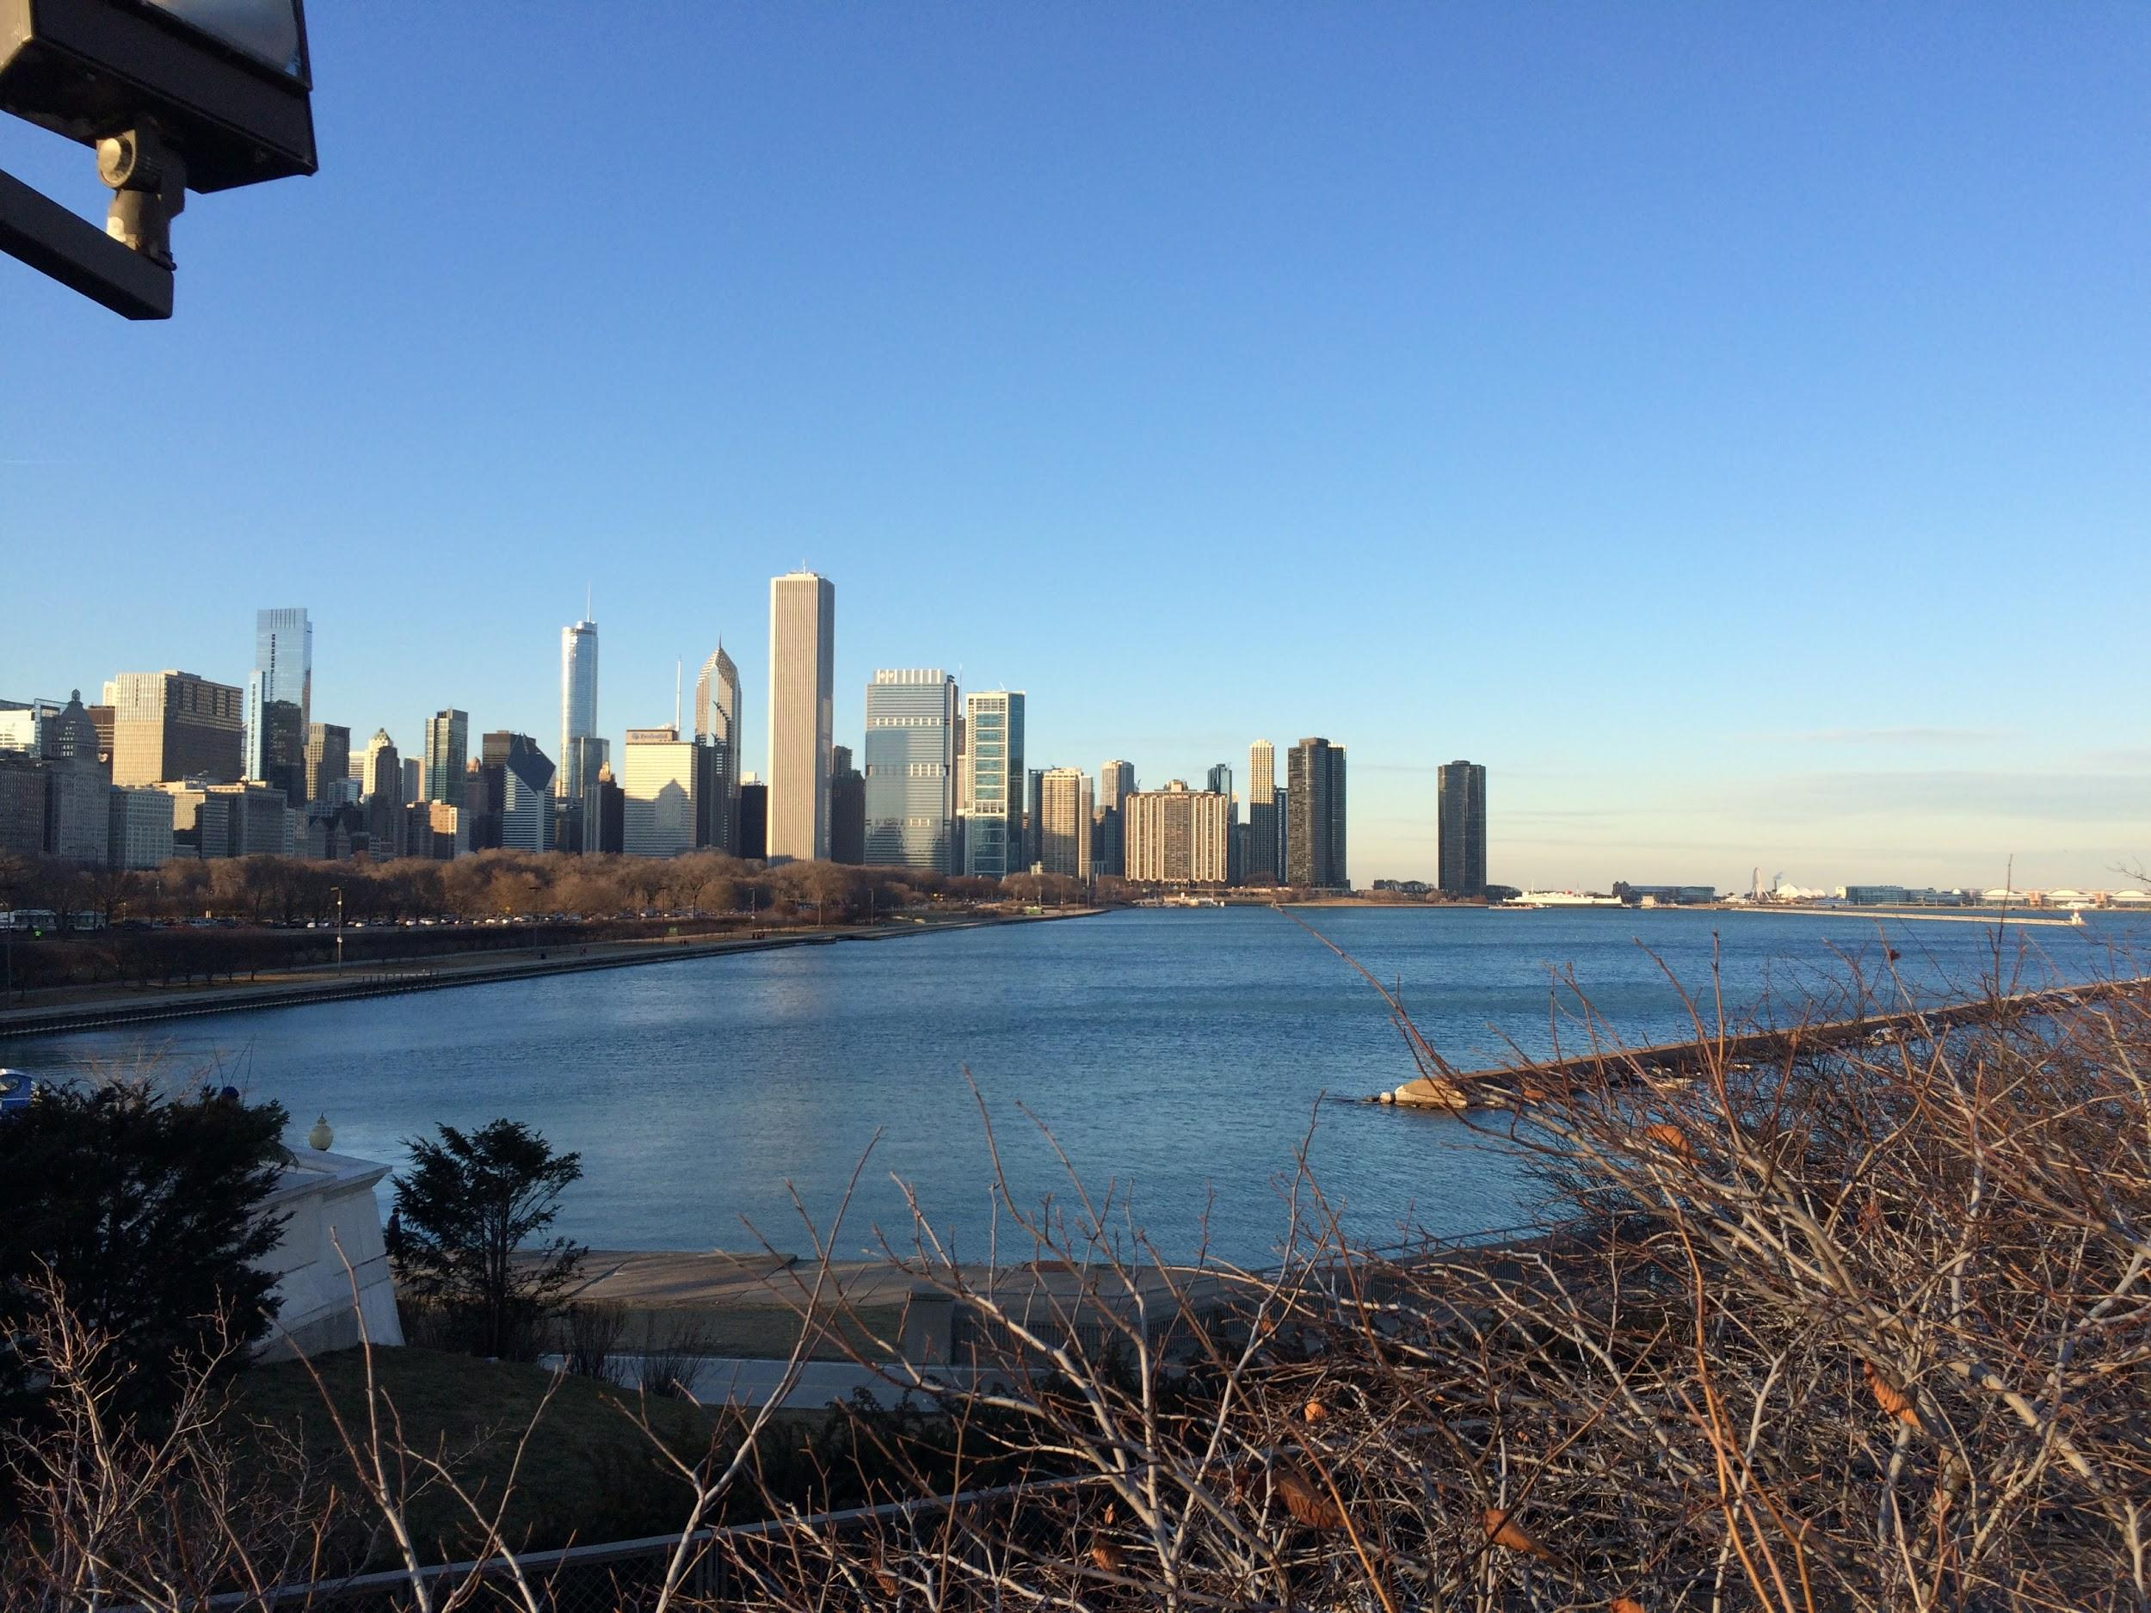
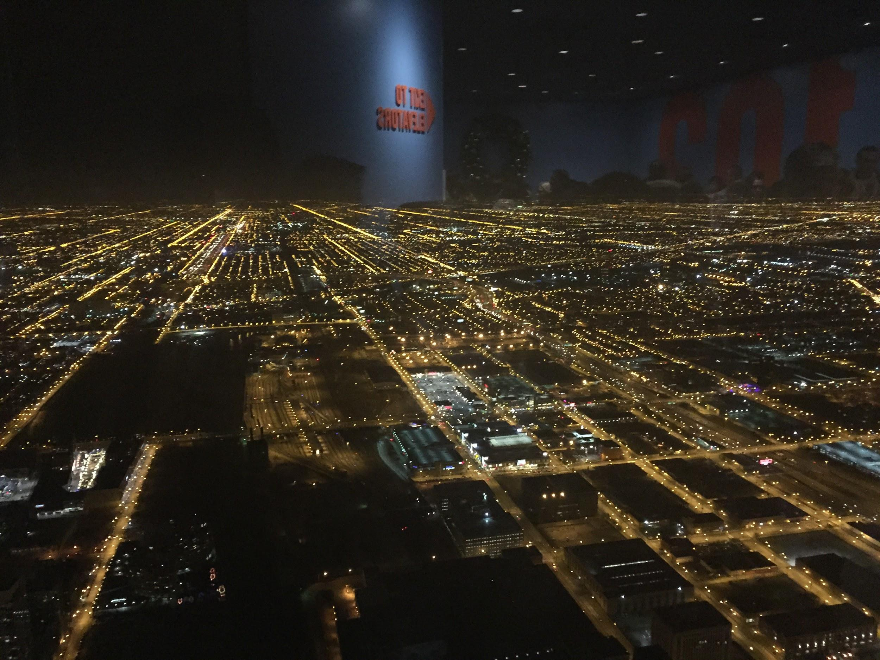
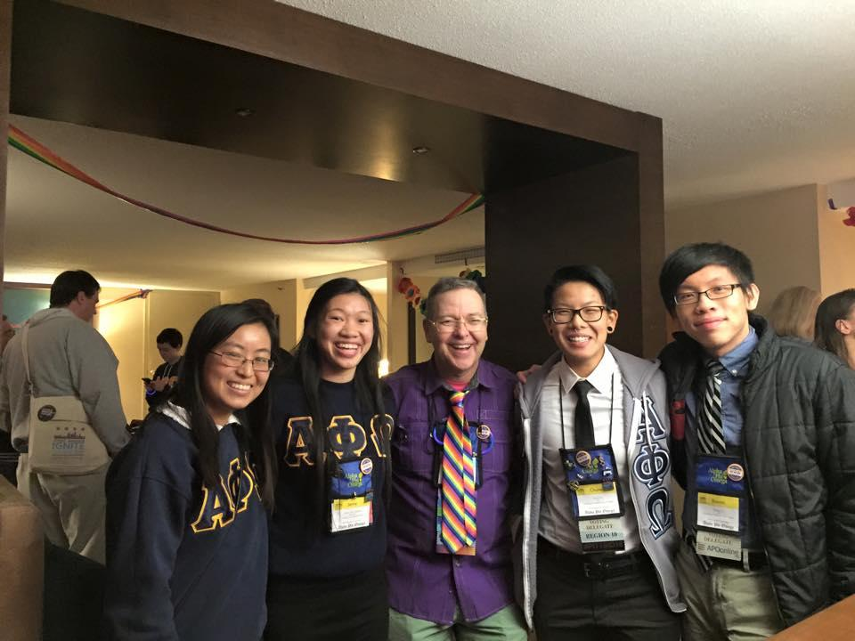
National Convention Recap

Slide 40

CAC
Paul Choung
cac@apo-x.org

Slide 41
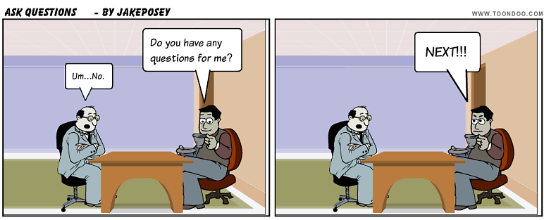
CAC@Kerckhoff
Friday, January 9th, 11:15 AM - 3:30 PM
Scheduled:
11:15 AM - Kelly Huang
12:10 PM - Shannon Ye
12:30 PM - Rita Chan
12:50 PM - Phuong-Tran Tran
1:30 PM - Justin Lin
1:50 PM - Shirley Lin
2:30 PM - Justin Liou
3:15 PM - Margaret Le

Slide 42

Ass. CAC Tristan Darvin
TT
asscac@apo-x.org

Slide 43

A
C
S

Slide 44
SECTIONALS

Slide 45

LESS THAN
3 MONTHS AWAY! :D
We are looking for people to join these committees:
Workshops Gifts
External Food
Registration Promo Vid
Printing T-Shirts
A/V Finance

Slide 46
[AN] EXCOMM ELECTIONS - PART I
President
Service Vice President(s)
Membership Vice President(s)
Pledge Parent(s)
Administrative Vice President(s)
Finance Vice President(s) → Contingent on time
PROCEDURE
3 minute presentation per candidate/pair
5 total questions asked to all candidates (Option to extend with motion)
1 minute response per candidate/pair
3 speakers per candidate/pair in rotation (Option to extend with motion)
Vote by ballot (Winner must obtain 50% +1, if not, we will have a runoff with top 2 candidates/pairs)

Slide 47
PRESIDENT
Melissa Ma
Miye Nakashima
PROCEDURE
3 minute presentation per candidate/pair
5 total questions asked to all candidates (Option to extend with motion)
1 minute response per candidate/pair
3 speakers per candidate/pair in rotation (Option to extend with motion)
Vote by ballot (Winner must obtain 50% +1, if not, we will have a runoff with top 2 candidates/pairs)

Slide 48
PRESIDENT
Melissa Ma
Miye Nakashima
PROCEDURE
3 minute presentation per candidate/pair
5 total questions asked to all candidates (Option to extend with motion)
1 minute response per candidate/pair
3 speakers per candidate/pair in rotation (Option to extend with motion)
Vote by ballot (Winner must obtain 50% +1, if not, we will have a runoff with top 2 candidates/pairs)

Slide 49
PRESIDENT
Melissa Ma
Miye Nakashima
PROCEDURE
3 minute presentation per candidate/pair
5 total questions asked to all candidates (Option to extend with motion)
1 minute response per candidate/pair
3 speakers per candidate/pair in rotation (Option to extend with motion)
Vote by ballot (Winner must obtain 50% +1, if not, we will have a runoff with top 2 candidates/pairs)

Slide 50
PRESIDENT
Melissa Ma
Miye Nakashima
PROCEDURE
3 minute presentation per candidate/pair
5 total questions asked to all candidates (Option to extend with motion)
1 minute response per candidate/pair
3 speakers per candidate/pair in rotation (Option to extend with motion)
Vote by ballot (Winner must obtain 50% +1, if not, we will have a runoff with top 2 candidates/pairs)

Slide 51
PRESIDENT
Melissa Ma
Miye Nakashima
PROCEDURE
3 minute presentation per candidate/pair
5 total questions asked to all candidates (Option to extend with motion)
1 minute response per candidate/pair
3 speakers per candidate/pair in rotation (Option to extend with motion)
Vote by ballot (Winner must obtain 50% +1, if not, we will have a runoff with top 2 candidates/pairs)

Slide 52
CONGRATULATIONS
Our next President:
Miye Nakashima
PROCEDURE
3 minute presentation per candidate/pair
5 total questions asked to all candidates (Option to extend with motion)
1 minute response per candidate/pair
3 speakers per candidate/pair in rotation (Option to extend with motion)
Vote by ballot (Winner must obtain 50% +1, if not, we will have a runoff with top 2 candidates/pairs)

Slide 53
SERVICE VP(s)
Tina Ngo
PROCEDURE
3 minute presentation per candidate/pair
5 total questions asked to all candidates (Option to extend with motion)
1 minute response per candidate/pair
3 speakers per candidate/pair in rotation (Option to extend with motion)
Vote by ballot (Winner must obtain 50% +1, if not, we will have a runoff with top 2 candidates/pairs)

Slide 54
SERVICE VP(s)
Tina Ngo
PROCEDURE
3 minute presentation per candidate/pair
5 total questions asked to all candidates (Option to extend with motion)
1 minute response per candidate/pair
3 speakers per candidate/pair in rotation (Option to extend with motion)
Vote by ballot (Winner must obtain 50% +1, if not, we will have a runoff with top 2 candidates/pairs)

Slide 55
SERVICE VP(s)
Tina Ngo
PROCEDURE
3 minute presentation per candidate/pair
5 total questions asked to all candidates (Option to extend with motion)
1 minute response per candidate/pair
3 speakers per candidate/pair in rotation (Option to extend with motion)
Vote by ballot (Winner must obtain 50% +1, if not, we will have a runoff with top 2 candidates/pairs)

Slide 56
SERVICE VP(s)
Tina Ngo
PROCEDURE
3 minute presentation per candidate/pair
5 total questions asked to all candidates (Option to extend with motion)
1 minute response per candidate/pair
3 speakers per candidate/pair in rotation (Option to extend with motion)
Vote by ballot (Winner must obtain 50% +1, if not, we will have a runoff with top 2 candidates/pairs)

Slide 57
SERVICE VP(s)
Tina Ngo
PROCEDURE
3 minute presentation per candidate/pair
5 total questions asked to all candidates (Option to extend with motion)
1 minute response per candidate/pair
3 speakers per candidate/pair in rotation (Option to extend with motion)
Vote by ballot (Winner must obtain 50% +1, if not, we will have a runoff with top 2 candidates/pairs)

Slide 58
CONGRATULATIONS
Our next Service Vice President(s):
Tina Ngo
PROCEDURE
3 minute presentation per candidate/pair
5 total questions asked to all candidates (Option to extend with motion)
1 minute response per candidate/pair
3 speakers per candidate/pair in rotation (Option to extend with motion)
Vote by ballot (Winner must obtain 50% +1, if not, we will have a runoff with top 2 candidates/pairs)

Slide 59
MEMBERSHIP VP(s)
Chanel Ng & Rachel Belyea
Vivian Shih & George Hsin
PROCEDURE
3 minute presentation per candidate/pair
5 total questions asked to all candidates (Option to extend with motion)
1 minute response per candidate/pair
3 speakers per candidate/pair in rotation (Option to extend with motion)
Vote by ballot (Winner must obtain 50% +1, if not, we will have a runoff with top 2 candidates/pairs)

Slide 60
MEMBERSHIP VP(s)
Chanel Ng & Rachel Belyea
Vivian Shih & George Hsin
PROCEDURE
3 minute presentation per candidate/pair
5 total questions asked to all candidates (Option to extend with motion)
1 minute response per candidate/pair
3 speakers per candidate/pair in rotation (Option to extend with motion)
Vote by ballot (Winner must obtain 50% +1, if not, we will have a runoff with top 2 candidates/pairs)

Slide 61
MEMBERSHIP VP(s)
Chanel Ng & Rachel Belyea
Vivian Shih & George Hsin
PROCEDURE
3 minute presentation per candidate/pair
5 total questions asked to all candidates (Option to extend with motion)
1 minute response per candidate/pair
3 speakers per candidate/pair in rotation (Option to extend with motion)
Vote by ballot (Winner must obtain 50% +1, if not, we will have a runoff with top 2 candidates/pairs)

Slide 62
MEMBERSHIP VP(s)
Chanel Ng & Rachel Belyea
Vivian Shih & George Hsin
PROCEDURE
3 minute presentation per candidate/pair
5 total questions asked to all candidates (Option to extend with motion)
1 minute response per candidate/pair
3 speakers per candidate/pair in rotation (Option to extend with motion)
Vote by ballot (Winner must obtain 50% +1, if not, we will have a runoff with top 2 candidates/pairs)

Slide 63
MEMBERSHIP VP(s)
Chanel Ng & Rachel Belyea
Vivian Shih & George Hsin
PROCEDURE
3 minute presentation per candidate/pair
5 total questions asked to all candidates (Option to extend with motion)
1 minute response per candidate/pair
3 speakers per candidate/pair in rotation (Option to extend with motion)
Vote by ballot (Winner must obtain 50% +1, if not, we will have a runoff with top 2 candidates/pairs)

Slide 64
CONGRATULATIONS
Our next Membership Vice President(s):
Chanel Ng & Rachel Belyea
PROCEDURE
3 minute presentation per candidate/pair
5 total questions asked to all candidates (Option to extend with motion)
1 minute response per candidate/pair
3 speakers per candidate/pair in rotation (Option to extend with motion)
Vote by ballot (Winner must obtain 50% +1, if not, we will have a runoff with top 2 candidates/pairs)

Slide 65
PLEDGE PARENT(S)
Ann Dai & Josh Chang
PROCEDURE
3 minute presentation per candidate/pair
5 total questions asked to all candidates (Option to extend with motion)
1 minute response per candidate/pair
3 speakers per candidate/pair in rotation (Option to extend with motion)
Vote by ballot (Winner must obtain 50% +1, if not, we will have a runoff with top 2 candidates/pairs)

Slide 66
PLEDGE PARENT(S)
Ann Dai & Josh Chang
PROCEDURE
3 minute presentation per candidate/pair
5 total questions asked to all candidates (Option to extend with motion)
1 minute response per candidate/pair
3 speakers per candidate/pair in rotation (Option to extend with motion)
Vote by ballot (Winner must obtain 50% +1, if not, we will have a runoff with top 2 candidates/pairs)

Slide 67
PLEDGE PARENT(S)
Ann Dai & Josh Chang
PROCEDURE
3 minute presentation per candidate/pair
5 total questions asked to all candidates (Option to extend with motion)
1 minute response per candidate/pair
3 speakers per candidate/pair in rotation (Option to extend with motion)
Vote by ballot (Winner must obtain 50% +1, if not, we will have a runoff with top 2 candidates/pairs)

Slide 68
PLEDGE PARENT(S)
Ann Dai & Josh Chang
PROCEDURE
3 minute presentation per candidate/pair
5 total questions asked to all candidates (Option to extend with motion)
1 minute response per candidate/pair
3 speakers per candidate/pair in rotation (Option to extend with motion)
Vote by ballot (Winner must obtain 50% +1, if not, we will have a runoff with top 2 candidates/pairs)

Slide 69
PLEDGE PARENT(S)
Ann Dai & Josh Chang
PROCEDURE
3 minute presentation per candidate/pair
5 total questions asked to all candidates (Option to extend with motion)
1 minute response per candidate/pair
3 speakers per candidate/pair in rotation (Option to extend with motion)
Vote by ballot (Winner must obtain 50% +1, if not, we will have a runoff with top 2 candidates/pairs)

Slide 70
CONGRATULATIONS
Our next Pledge Parent(s):
Ann Dai & Josh Chang
PROCEDURE
3 minute presentation per candidate/pair
5 total questions asked to all candidates (Option to extend with motion)
1 minute response per candidate/pair
3 speakers per candidate/pair in rotation (Option to extend with motion)
Vote by ballot (Winner must obtain 50% +1, if not, we will have a runoff with top 2 candidates/pairs)

Slide 71
ADMINISTRATIVE VP(S)
Nhat Thai & Sandra Huynh
PROCEDURE
3 minute presentation per candidate/pair
5 total questions asked to all candidates (Option to extend with motion)
1 minute response per candidate/pair
3 speakers per candidate/pair in rotation (Option to extend with motion)
Vote by ballot (Winner must obtain 50% +1, if not, we will have a runoff with top 2 candidates/pairs)

Slide 72
ADMINISTRATIVE VP(S)
Nhat Thai & Sandra Huynh
PROCEDURE
3 minute presentation per candidate/pair
5 total questions asked to all candidates (Option to extend with motion)
1 minute response per candidate/pair
3 speakers per candidate/pair in rotation (Option to extend with motion)
Vote by ballot (Winner must obtain 50% +1, if not, we will have a runoff with top 2 candidates/pairs)

Slide 73
ADMINISTRATIVE VP(S)
Nhat Thai & Sandra Huynh
PROCEDURE
3 minute presentation per candidate/pair
5 total questions asked to all candidates (Option to extend with motion)
1 minute response per candidate/pair
3 speakers per candidate/pair in rotation (Option to extend with motion)
Vote by ballot (Winner must obtain 50% +1, if not, we will have a runoff with top 2 candidates/pairs)

Slide 74
ADMINISTRATIVE VP(S)
Nhat Thai & Sandra Huynh
PROCEDURE
3 minute presentation per candidate/pair
5 total questions asked to all candidates (Option to extend with motion)
1 minute response per candidate/pair
3 speakers per candidate/pair in rotation (Option to extend with motion)
Vote by ballot (Winner must obtain 50% +1, if not, we will have a runoff with top 2 candidates/pairs)

Slide 75
ADMINISTRATIVE VP(S)
Nhat Thai & Sandra Huynh
PROCEDURE
3 minute presentation per candidate/pair
5 total questions asked to all candidates (Option to extend with motion)
1 minute response per candidate/pair
3 speakers per candidate/pair in rotation (Option to extend with motion)
Vote by ballot (Winner must obtain 50% +1, if not, we will have a runoff with top 2 candidates/pairs)

Slide 76
CONGRATULATIONS
Our next Administrative Vice President(s):
Sandra Huynh & Nhat Thai
PROCEDURE
3 minute presentation per candidate/pair
5 total questions asked to all candidates (Option to extend with motion)
1 minute response per candidate/pair
3 speakers per candidate/pair in rotation (Option to extend with motion)
Vote by ballot (Winner must obtain 50% +1, if not, we will have a runoff with top 2 candidates/pairs)

Slide 77
FINANCE VP(S)
Sheila Wahezi & Thu Mai
PROCEDURE
3 minute presentation per candidate/pair
5 total questions asked to all candidates (Option to extend with motion)
1 minute response per candidate/pair
3 speakers per candidate/pair in rotation (Option to extend with motion)
Vote by ballot (Winner must obtain 50% +1, if not, we will have a runoff with top 2 candidates/pairs)

Slide 78
FINANCE VP(S)
Sheila Wahezi & Thu Mai
PROCEDURE
3 minute presentation per candidate/pair
5 total questions asked to all candidates (Option to extend with motion)
1 minute response per candidate/pair
3 speakers per candidate/pair in rotation (Option to extend with motion)
Vote by ballot (Winner must obtain 50% +1, if not, we will have a runoff with top 2 candidates/pairs)

Slide 79
FINANCE VP(S)
Sheila Wahezi & Thu Mai
PROCEDURE
3 minute presentation per candidate/pair
5 total questions asked to all candidates (Option to extend with motion)
1 minute response per candidate/pair
3 speakers per candidate/pair in rotation (Option to extend with motion)
Vote by ballot (Winner must obtain 50% +1, if not, we will have a runoff with top 2 candidates/pairs)

Slide 80
FINANCE VP(S)
Sheila Wahezi & Thu Mai
PROCEDURE
3 minute presentation per candidate/pair
5 total questions asked to all candidates (Option to extend with motion)
1 minute response per candidate/pair
3 speakers per candidate/pair in rotation (Option to extend with motion)
Vote by ballot (Winner must obtain 50% +1, if not, we will have a runoff with top 2 candidates/pairs)

Slide 81
FINANCE VP(S)
Sheila Wahezi & Thu Mai
PROCEDURE
3 minute presentation per candidate/pair
5 total questions asked to all candidates (Option to extend with motion)
1 minute response per candidate/pair
3 speakers per candidate/pair in rotation (Option to extend with motion)
Vote by ballot (Winner must obtain 50% +1, if not, we will have a runoff with top 2 candidates/pairs)

Slide 82
CONGRATULATIONS
Our next Finance Vice President(s):
Sheila Wahezi & Thu Mai
PROCEDURE
3 minute presentation per candidate/pair
5 total questions asked to all candidates (Option to extend with motion)
1 minute response per candidate/pair
3 speakers per candidate/pair in rotation (Option to extend with motion)
Vote by ballot (Winner must obtain 50% +1, if not, we will have a runoff with top 2 candidates/pairs)

Slide 83
Nominations
Fellowship VP(s)
Brian Martin & Sarah Yi
Lucy Diep & Katherine Cardoza
Historian
Patricia Natalie

Slide 84
Nominations
Sergeant-at-Arms
Irene Tang
Kevin Vu
Interchapter Chair
Althea Alquitran

Slide 85
Nominations
Chair of the Advisory Committee

Slide 86
Alpha Nu Namesake
NOMINATIONS OPEN UNTIL CM11!
ELECTIONS CM11!
Last two namesakes: Yuna Choi and Anna Lee
For those who have given a lot to CHI CHAPTER
Nominations
Winnie Banh
Andrew Ma
Kevin Lee
Paul Choung

